Slide 1
EEG Source Localization Algorithm based on 3D-Grid Source Model
Qinyuan (David) Wei
Supervisor: Nicole Zhou
Mentor: Wentai Liu
Date: 07/28/2017

Slide 2
Outline
Background
Aims
The Inverse Problem
State-of-the-Art
Research Plan
Notes:
Last two weeks:
Study all classical localization algorithms
Do a literature review about the state-of-the-art
Write a report about the state-of-the-art methods

Slide 3
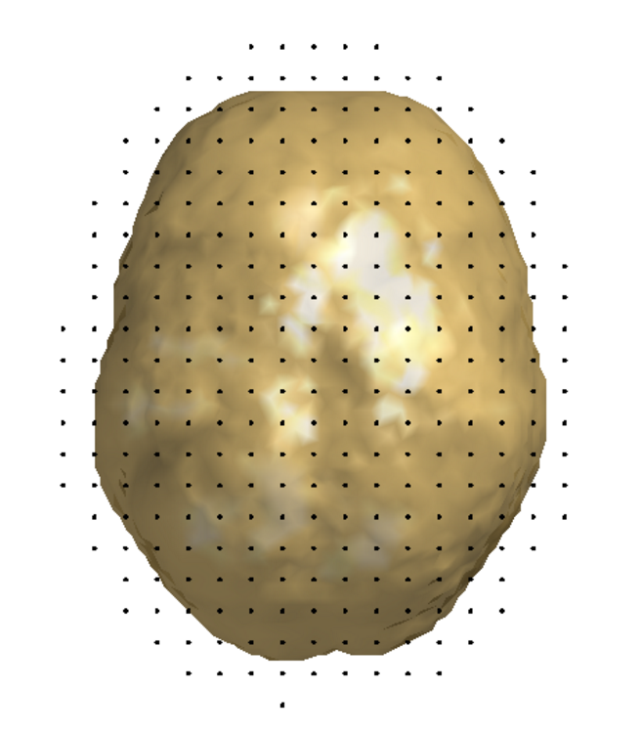
Background
EEG localization----good temporal and spatial resolution
2D cortex model
3D grid source model
Notes:
EEG can achieve a good temporal resolution but does not have good spatial resolution.
Using EEG source localization method can improve its spatial resolution.
For now, most algorithms are based on 2D cortex model. They can only detect the source on the gray matter. But we also want to know what happen in deeper brain, such as the source on the thalamus.
We have tested some algorithms in 3D model, which results are blur and inaccurate.
So we need to find an algorithm which fits the 3D model, and has a sparse result.

Slide 4
Aims
Find and implement a good algorithm for source localization based on 3D source model.
Study the relationship between spatial resolution of the algorithm and the number of electrodes and the number of voxel points.
Develop metrics for the algorithm performance.
Make a clear MATLAB toolbox and write a summary report.

Slide 5
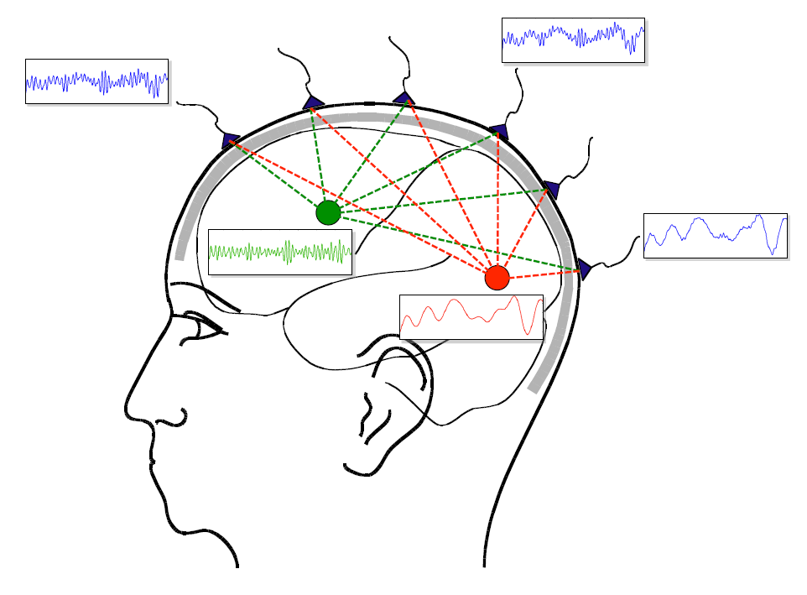
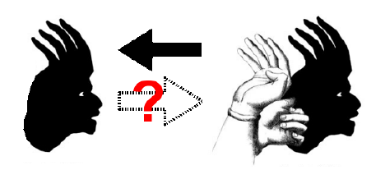

The Inverse problem
ill-posed problem
[1]
Notes:
For the source localization, the key is to solve the inverse problem.
The green dot and red dot are two sources in brain. They may be the current which generated by the neurons. When the current is generated, the electromagnetic fields are changed, which is the source signals.
The signals pass through three layers of head and reach the sensors outside the scalp.
The inverse problem is to locate the sources by the signals we collected from sensors.
The most important feature of this problem is that it is an ill-posed problem, which means its solution is not unique. The ill-posed problem is like guessing thing by its shadow. If we know what the thing is, we can ascertain the shadow of it. But if we only know the shadow, we can’t make sure how it comes.
So we have to use optimization methods to compute it.
It is basically using the well-posed problem, which means the ones have unique solution, to approximate the ill-posed problem.
And this function describes the model, n denote the noise; A is the lead field, which describes the electromagnetic environment in the head; Fii is the signals measured on the sensors and s is the sources.

Slide 6

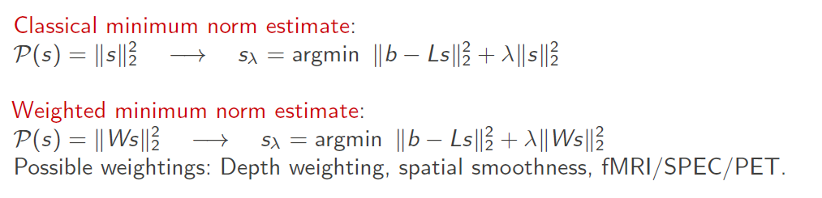
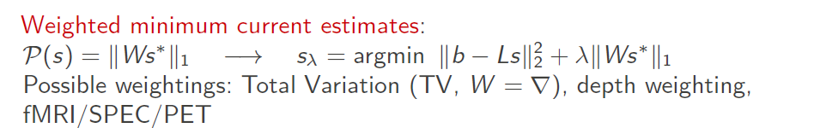
The Inverse Problem
Notes:
The popular way to solve the inverse problem is using the regularization methods.
The typical steps of the regularization method is: 1. find the optimization function, like this one. In the field of regularization methods, different algorithms have different factors in the function, but the structure of the function is the same. 2. set the factors in the optimization function. In different methods, the factors in the functions are different, that’s why they have different performance.
And here are the classical solutions in the regularization method. In the regularization method, l1-norm leads to a sparse result, which means the source it finds will be focused in a small area; and l2-norm leads to a smooth result, which means it will show more details in the source, but maybe blur.
For TV, it replace the W with a total variation operator. gradient

Slide 7
State-of-the-Art
gFOTV
VW-SSI
IRES
cMEM
Notes:
I have done a literature review on this topic these days and here are some state of the art methods on this issue.
I pick them out because I think they are both well performance and sparseness enough.

Slide 8
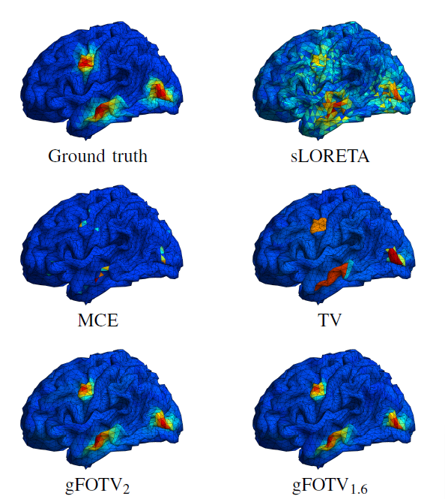

gFOTV
(Graph Fractional-Order Total Variation)
$$\min\left(\frac{1}{2}{\left\|Au−b\right\|}_{2}^{2}+λ{\left\|∇^{1.6}u\right\|}_{1}\right)$$
Notes:
TV (total variation) is a method which solves the problem in the transform-domain. It can achieve high accuracy and sparse. Based on the TV method, gFOTV uses fractional-order to enhance the total variation, which achieves a balance between sparse and smooth.
Also, we can moderate the degree of sparse and smooth by adjust a parameter in the function.
It changes the Laplace operator in the second part of the TV optimization function into a fractional order operator, which makes it more smooth than the original TV method, but still sparse and accurate.
The lower the parameter is, the higher spatial resolution it can achieve.

Slide 9
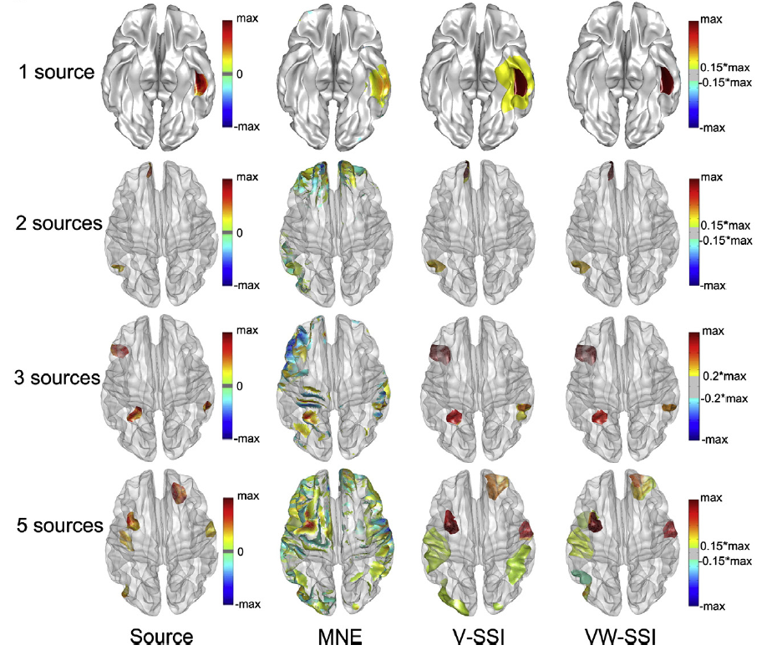

VW-SSI
(variation and wavelet based sparse source imaging)
[3]
Notes:
VW-SSI (variation and wavelet based sparse source imaging, 2013) is a method based on l1-norm regularization with the enforcement of transform sparseness in both variation and wavelet domains.
n denotes the noise and A is the lead field.
V is the variation vector used in variation transform. $W_{m}$is the wavelet transform matrix. $λ>0$ is the hyper-parameter to balance variation and wavelet penalties.

Slide 10
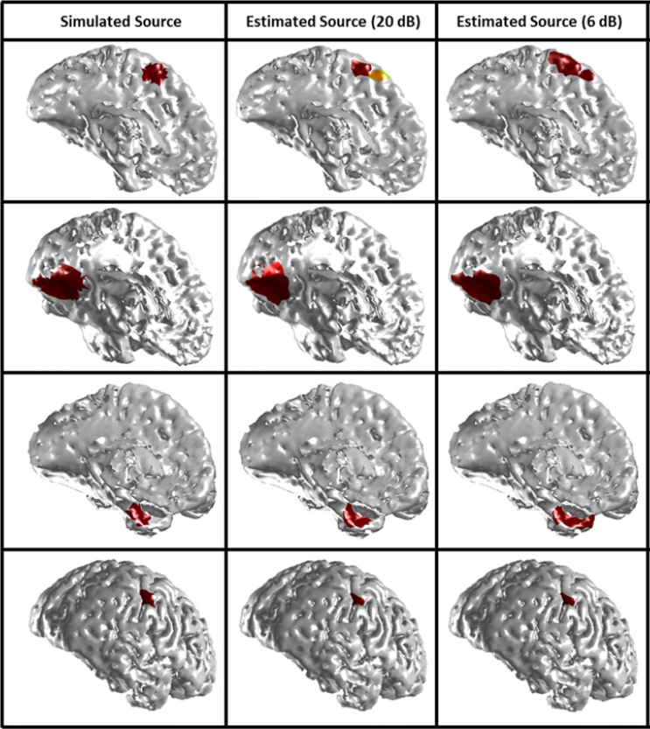
IRES
(Iteratively Reweighted Edge Sparsity Minimization)
[4]
Notes:
tested on the Brainstorm epilepsy data
IRES (iteratively reweighted edge sparsity minimization, 2016) is a method, which uses an iterative reweighting strategy to penalize locations that are less likely to contain any source.
The brief idea of this algorithm is to compute the optimization function iteratively, until the result doesn’t change.
We can see this method is sparse and accurate and has a great performance when SNR is low.

Slide 11
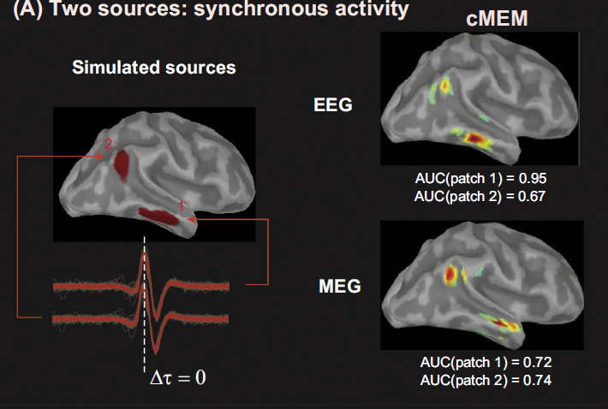
cMEM
(coherent Maximum Entropy on the Mean)
[2]
Notes:
cMEM (coherent Maximum Entropy on the Mean, 2013) is an improvement of MEM method. The MEM solver relies on a probabilistic (Bayesian) approach where inference on the current source intensities is estimated from the informational content in the data (notion of maximum of entropy).
The article I read suggests that cMEM is better than MNE and LORETA, which is more sparse and accurate.
And there is a matlab toolbox online.

Slide 12
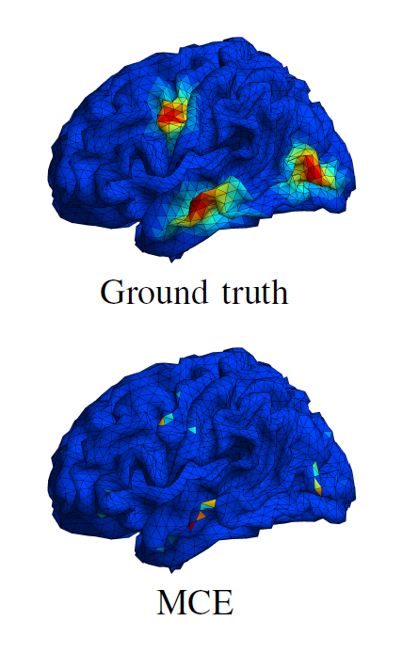

MCE
(Minimum Current Estimates)
$$\min{(}{\left\|Au−b\right\|}_{2}^{2}+λ{\left\|wu\right\|}_{1})$$
S.T.$\left\|Au−b\right\|≤ε$
[5]
Notes:
Also I want to mention MCE, it is a classical algorithm but it is very sparse.
MCE (Minimum Current Estimates) is a method based on the MNE, which is raised in 1999. It minimizes the sum of the absolute currents (l-1 norm).

Slide 13
Research plan
Methods may apply:
MCE
VW-SSI
cMEM
…
Notes:
For the next step, I will try the MCE method first, because it is very sparse and there is an existing toolbox of it.
Then I will try VW-SSI and cMEM.
Based on the performance of these methods, I will try other methods.

Slide 14

Future Plan
Week 1-2
Week 3-4
Week 5-6
Week 7-8
Read papers
Literature review
Find and implement algorithms
Matlab codes
Run tests on different dataset
Develop metrics for 3D source localization
Summarize the work
Make a toolbox
Notes:
In the first two weeks I have done reading papers and literature review.
In the following six weeks I will do these jobs.

Slide 15
References
[1] Robert Oostenveld, Pascal Fries, Eric Maris, and Jan-Mathijs Schoffelen, “FieldTrip: Open Source Software for Advanced Analysis of MEG, EEG, and Invasive Electrophysiological Data,” Computational Intelligence and Neuroscience, vol. 2011
[2] Chowdhury R A, Merlet I, Birot G, et al. Complex patterns of spatially extended generators of epileptic activity: Comparison of source localization methods cMEM and 4-ExSo-MUSIC on High Resolution EEG and MEG data[J]. Neuroimage, 2016, 143:175-195.
[3] Zhu M, Zhang W, Dickens D L, et al. Reconstructing spatially extended brain sources via enforcing multiple transform sparseness.[J]. Neuroimage, 2014, 86(2):280.
[4] Sohrabpour A, Lu Y, Worrell G, et al. Imaging brain source extent from EEG/MEG by means of an iteratively reweighted edge sparsity minimization (IRES) strategy[J]. Neuroimage, 2016, 142:27-42.
[5] Uutela,K., Hämäläinen, M., and Somersalo,E.(1999).Visualization of magnetoencephalographic data using minimum current estimates. NeuroImage 10,173–180.doi:10.1006/nimg.1999.0454
[6] "A lecture on the inverse problem of EEG/MEG" , Felix Lucka, WWU Münster, May 14, 2012.

Slide 16
Thanks for Your Time

Slide 17
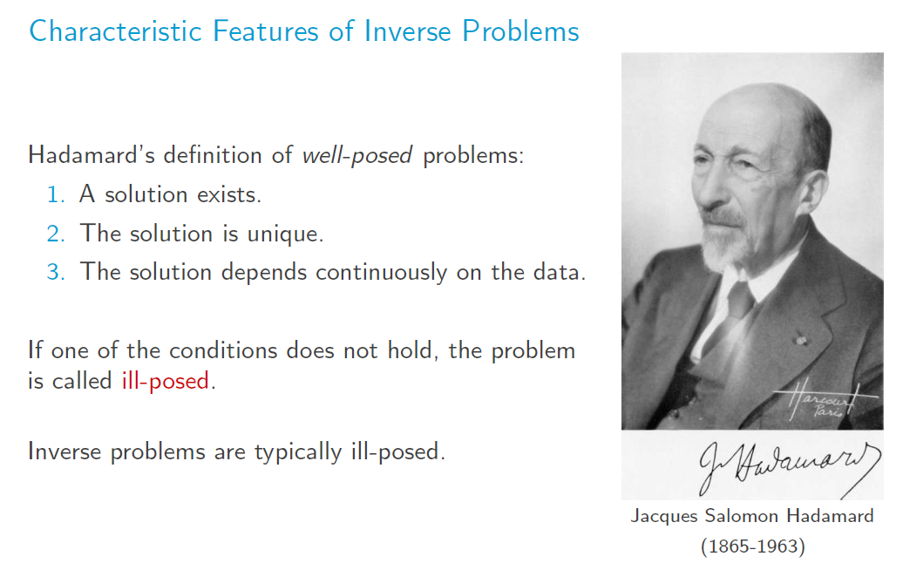

Slide 18
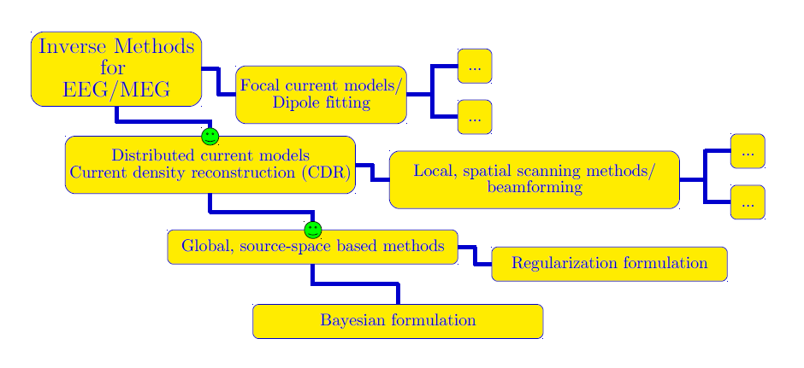

Slide 19
